Slide 1
Chapter 7 Interaction Design Models
Model Human Processor (MHP)
Keyboard Level Model (KLM)
GOMS
Modeling Structure
Modeling Dynamics
Physical Models
1-<number>

Slide 2
GOMS
Goal/task models can be used to explore the methods people use to accomplish their goals
Card et al. suggested that user interaction could be described by defining the sequential actions a person undertakes to accomplish a task.
The GOMS model has four components:
  goals
  operators
  methods
  selection rules
1-<number>

Slide 3
GOMS
Goals - Tasks are deconstructed as a set of goals and subgoals.
Operators - Tasks can only be carried out by undertaking specific actions.
Methods - Represent ways of achieving a goal
  Comprised of operators that facilitate method completion
Selection Rules - The method that the user chooses is determined by selection rules
1-<number>

Slide 4
GOMS – CMN-GOMS
CMN-GOMS can predict behavior and assess memory requirements
CMN-GOMS (named after Card, Moran, and Newell) -a detailed expansion of the general GOMS model
  Includes specific analysis procedures and notation descriptions
Can judge memory requirements (the depth of the nested goal structures)
Provides insight into user performance measures
1-<number>

Slide 5
CNM-GOMS example
GOAL: CLOSE-WINDOW
. [select GOAL: USE-MENU-METHOD
. . MOVE-MOUSE-TO-FILE-MENU
. . PULL-DOWN-FILE-MENU
. . CLICK-OVER-CLOSE-OPTION
GOAL: USE-CTRL-W-METHOD
. . PRESS-CONTROL-W-KEYS]
For a particular user, U1:
Rule 1: Select USE-MENU-METHOD unless another
rule applies
Rule 2: If the application is GAME,
select CTRL-W-METHOD
So here we have one Goal with either of two Methods, one of which requires a sequence of three Operators, the other requires just one Operator; for U1 we have 2 Selection rules

Slide 6
GOMS – Other GOMS Models
NGOMSL (Natural GOMS Language), developed by Kieras, provides a structured natural-language notation for GOMS analysis and describes the procedures for accomplishing that analysis
  NGOMSL Provides:
    A method for measuring the time it will take to learn specific method of operation
    A way to determine the consistency of a design’s methods of operation
Bonus learning – see ftp://www.eecs.umich.edu/people/kieras/GOMS/NGOMSL_Guide.pdf
1-<number>

Slide 7
Method for goal: Highlight arbitrary text
Step 1. Determine position of beginning of text (1.20 sec)
Step 2. Move cursor to beginning of text (1.10 sec)
Step 3. Click mouse button. (0.20 sec)
Step 4. Move cursor to end of text. (1.10 sec)
Step 5. Shift-click mouse button. (0.48 sec)
Step 6. Verify that correct text is highlighted (1.20 sec)
Step 7. Return with goal accomplished.
This NGOMSL model predicts that it will take 5.28 seconds to highlight arbitrary text.
1-<number>

Slide 8
GOMS – Other GOMS Models
CPM-GOMS represents
  Cognitive
  Perceptual
  Motor operators
CPM-GOMS uses Program Evaluation Review Technique (PERT) charts
  Maps task durations using the critical path method (CPM).
CPM-GOMS is based directly on the Model Human Processor
  Assumes that perceptual, cognitive, and motor processors function in parallel
1-<number>

Slide 9
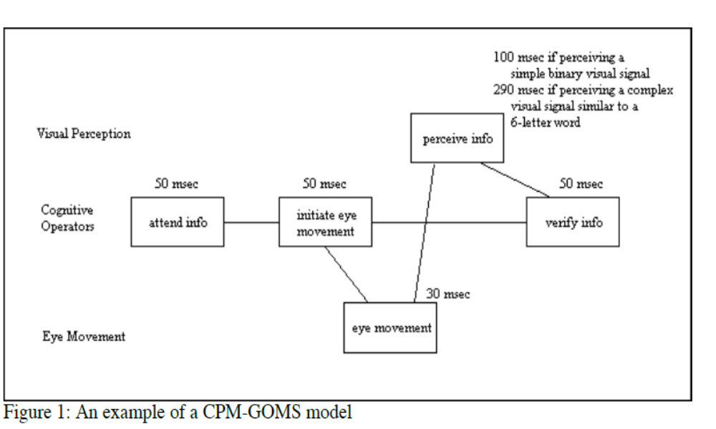
GOMS – Other GOMS Models
Program Evaluation Review Technique (PERT) chart Resource Flows
1-<number>

Slide 10
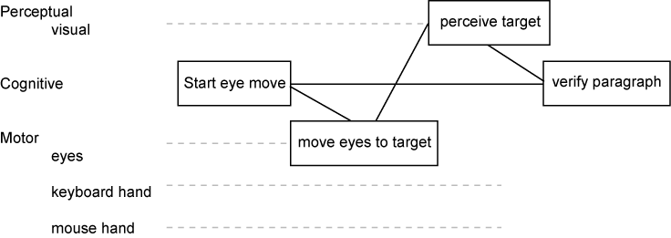
1-<number>

Slide 11
The sequence which produces the longest path through the chart is called the critical path, and it represents an estimate of the total time required to perform the task.
In this case (assuming a simple binary visual signal on the screen), the critical path is
50+50+30+100+50=280 msec.
This particular model assumes that visual perception, cognitive operations, and eye movements can occur in parallel.
1-<number>

Slide 12
Modeling Dynamics
Understanding the temporal aspects of interaction design is essential to the design of usable and useful systems
Interaction designs involve dynamic feedback loops between the user and the system
  User actions alter the state of the system, which in turn influences the user’s subsequent actions
Interaction designers need tools to explore how a system undergoes transitions from one state to the next
1-<number>

Slide 13
Modeling Dynamics – State Transition Networks
State Transition Networks can be used to explore:
  Menus
  Icons
  Tools
State Transition Networks can show the operation of peripheral devices
1-<number>

Slide 14
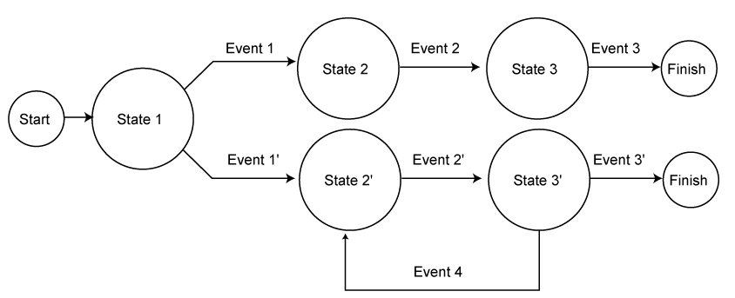
Modeling Dynamics – State Transition Networks
State Transition Network
STNs are appropriate for showing sequential operations that may involve choice on the part of the user, as well as for expressing iteration.
1-<number>

Slide 15
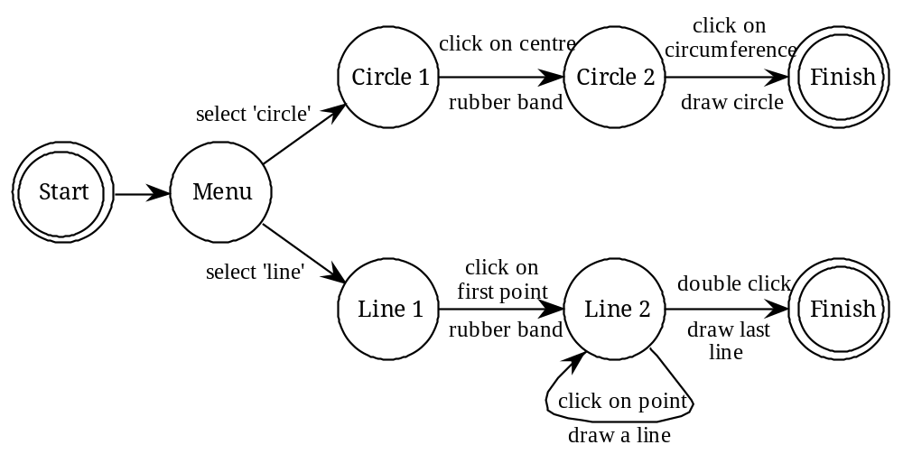
State transition networks (STN) – example
circles - states
arcs - actions/events

Slide 16
State transition networks - events
arc labels a bit cramped because:
  notation is `state heavy‘
  the events require most detail

Slide 17
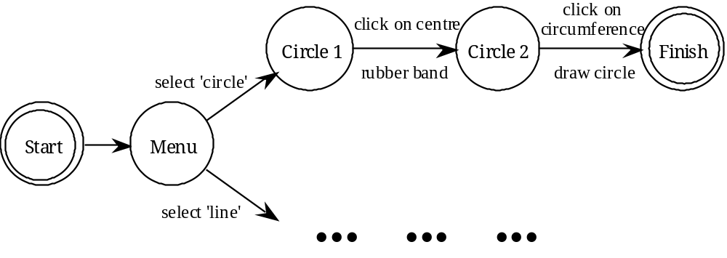
State transition networks - states
labels in circles a bit uninformative:
  states are hard to name
  but easier to visualise

Slide 18
Modeling Dynamics – Three-State Model
The Three-State Model can help designers to determine appropriate I/O devices for specific interaction designs
The TSM can reveal intrinsic device states and their subsequent transitions
  The interaction designer can use these to make determinations about the correlation between task and device
  Certain devices can be ruled out early in the design process if they do not possess the appropriate states for the specified task
1-<number>
Notes:
Draw circle → Mouse
Programming → keyboard

Slide 19
Modeling Dynamics – Three-State Model
The Three-State Model (TSM) is capable of describing three different types of pointer movements
  Tracked: A mouse device is tracked by the system and represented by the cursor position
  Dragged: A mouse also can be used to manipulate screen elements using drag-and-drop operations
  Disengaged movement: Some pointing devices can be moved without being tracked by the system, such as light pens or fingers on a touchscreen, and then reengage the system at random screen locations
1-<number>

Slide 20
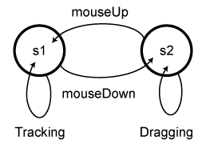
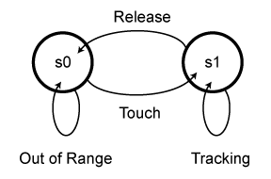
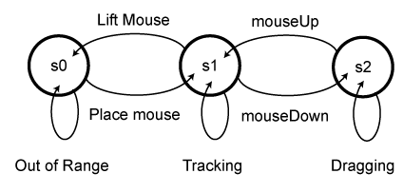
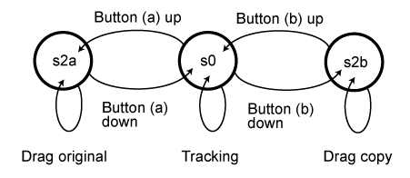
Modeling Dynamics – Three-State Model
_{Mouse Three-State Model.}
_{Trackpad Three-State Model.}
Alternate mouse Three-State Model.
Multibutton pointing device Three-State Model.
1-<number>

Slide 21
Modeling Dynamics – Glimpse Model
Forlines et al. (2005):
  Because the pen and finger give clear feedback about their location when they touch the screen and enter state 2, it is redundant for the cursor to track this movement
  Pressure-sensitive devices can take advantage of the s1 redundancy and map pressure to other features
  Undo commands coupled with a preview function (Glimpse) can be mapped to a pressure-sensitive direct input device
1-<number>

Slide 22
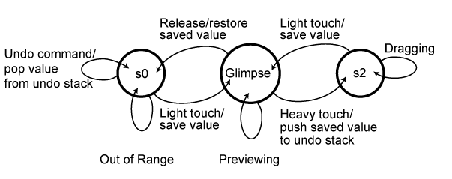
Modeling Dynamics – Glimpse Model
Previewing potentially useful to scroll momentarily to another part of a document (but then return to where you were), or to look around in a virtual environment
1-<number>

Slide 23
Modeling Dynamics – Glimpse Model
Some applications
  Pan and zoom interfaces—Preview different magnification levels
  Navigation in a 3D world—Quick inspection of an object from different perspectives
  Color selection in a paint program—Preview the effects of color manipulation
  Volume control—Preview different volume levels
  Window control—Moving or resizing windows to view occluded objects
  Scrollbar manipulation—Preview other sections of a document
1-<number>

Slide 24
Uses of State-Transition Networks
Not well-suited to complete models of modern GUIs
  Too many options (transitions) from any given state – combinatorial explosion (in fact, that’s just the flexibility a good GUI is supposed to give)
Better for limited/embedded user interfaces
  Automated teller machine
  Digital watch
  Car key/alarm device
Excellent for checking completeness of design
  Be sure that all transitions are represented (and hence will get coded and tested in implementation)
1-<number>

